Slide 1
DermaMNIST CNN Multi-class classification
Team members: Samantha Chan, Jessica Ho, Seon Min Kim, Wenli Xie, Belinda Chen

Slide 2
Project Overview: Skin Lesion Classification with DermaMNIST
Objective: Develop a CNN model to classify dermatoscopic images into seven skin lesion categories using the DermaMNIST dataset.
Goal: Support dermatological diagnostics by enabling robust and reproducible image-based disease classification.
Dataset:
Derived from the HAM10000 dataset via MedMNIST.
10,015 RGB images resized to 28×28 pixels.
Pre-split into training (7,007), validation, and test (2,005) sets.
Data Handling:
Images normalized from [0, 255] → [-1, 1] for stable training.
Efficient loading via PyTorch DataLoader.

Slide 3
Project Overview: Skin Lesion Classification with DermaMNIST
Model:
Custom CNN with convolutional + pooling layers for hierarchical feature extraction.
Fully connected layers for multi-class classification across seven categories.
Training:
Optimizer: SGD | Loss: Cross-Entropy | Epochs: 10 | Batch Size: 100 | LR: 0.01
Metrics logged per epoch: Accuracy, AUC
Evaluation:
Performance evaluated on the test set.
Results analyzed using confusion matrices and per-class metrics.
Expected Outcomes:
Establish baseline classification performance on DermaMNIST.
Identify key challenges (e.g., class imbalance, visual similarity).
Propose next steps such as data augmentation or deeper models.

Slide 4
Description
MedMNIST is a comprehensive collection of biomedical image datasets designed to facilitate machine learning research and education. It is comprised of 12 datasets for 2D and 6 datasets for 3D, encompassing a variety of imaging modalities such as X-rays, CT scans, ultrasounds, and dermatoscopic images. Each dataset is preprocessed into uniform sizes, 28×28 for 2D images and 28×28×28 for 3D volumes, making them lightweight and accessible for rapid prototyping and algorithm benchmarking. MedMNIST supports diverse classification tasks, including binary, multi-class, ordinal regression, and multi-label classification, with dataset sizes ranging from 100 to 100,000 samples. Additionally, MedMNIST+ offers higher-resolution versions (64×64, 128×128, and 224×224 for 2D; 64×64×64 for 3D) to support the development of more complex models.
DermaMNIST, a subset of MedMNIST, focuses on dermatological image classification. It is derived from the HAM10000 dataset, which contains 10,015 dermatoscopic images of pigmented skin lesions. These images are categorized into seven classes, including melanoma, basal cell carcinoma, and benign keratosis, among others. For consistency with the MedMNIST framework, the original images 600×450 pixels are resized to 28×28 pixels. The dataset is split into training, validation, and test sets in a 7:1:2 ratio. With its compact size and standardized format, DermaMNIST is particularly suitable for algorithm prototyping, and lightweight model evaluation in dermatological imaging.

Slide 5
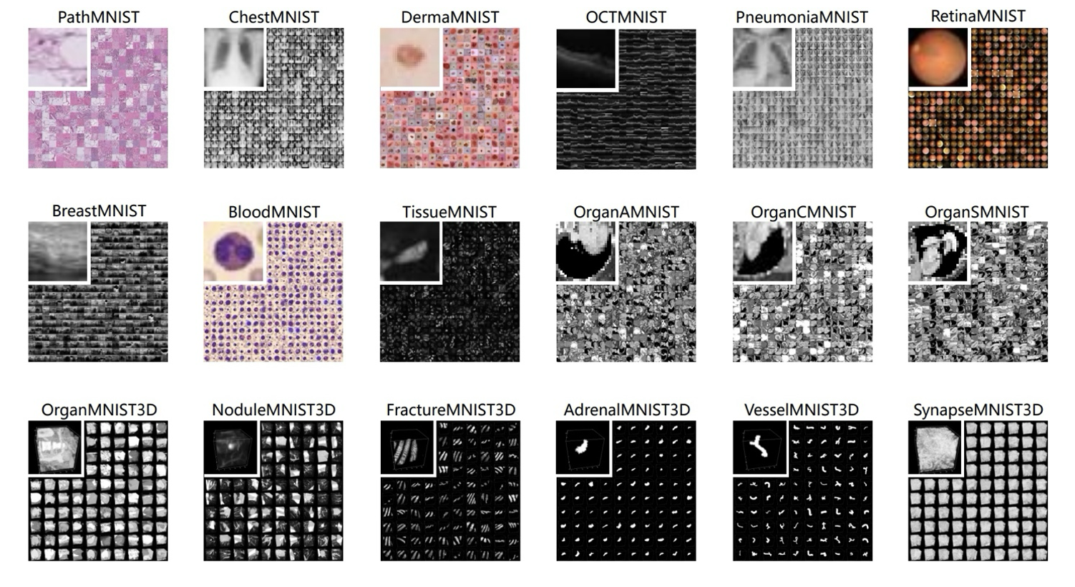

Slide 6
Dependencies
Python version: 3.8+
Dataset: medmnist
To run the code, please ensure the following packages are installed:
Torch
Torchvision
Scikit-learn
Numpy
Pandas
Matplotlib
Medmnist (dermamnist)
Run the code in the Jupyter Notebook

Slide 7
Methods - Data Pre-processing
Split the dataset into training and testing sets
Training: 7,007
Testing: 2,005
Convert images to tensors
Converting pixel values from [0, 255] to [0, 1]
Normalize tensors by rescaling from [0,1] to [-1, 1] to center image around 0.
Make gradients more stable
Avoid bias due to undcentered inputs
Helps layers operate more efficiently

Slide 8
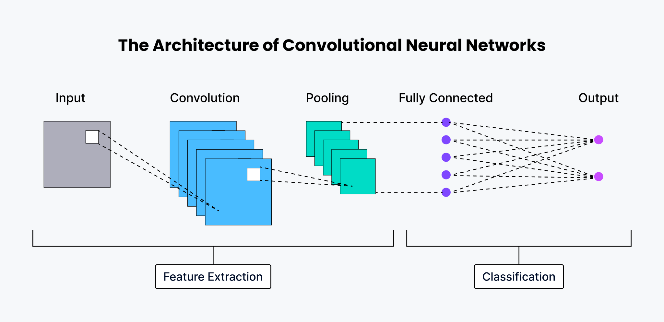
Methods - Convolutional Neural Network (CNN)
Why a Convolutional Neural Network?
Hierarchical feature learning that enables extraction of complex image features
Computationally efficient
Automatic feature extraction; does not need manual feature engineering
What is a CNN?
Type of feed-forward neural network that learns features via filter optimization
Consists of input layer, hidden layers, and output layer

Slide 9
Methods - Our CNN Model
Input Layer: 3-channel RGB dermatoscopic image (28 pixels x 28 pixels)
Hidden Layer | Operation Steps in Layer | Output Channels
Conv1 | 3x3 Convolution + Batch Normalization + ReLu Activation Function | 16
Conv2 | 3x3 Convolution + Batch Normalization + ReLu Activation Function + Max Pooling Layer | 16
Conv3 | 3x3 Convolution + Batch Normalization ReLu Activation Function | 64
Conv4 | 3x3 Convolution + Batch Normalization + ReLu Activation Function + Max Pooling Layer | 64
Output Layer: Vector of probabilities across the 7 classes

Slide 10
Methods - Model Training
Training loop steps:
Input image batch and labels
Predict probabilities for each class using CNN
Compute loss
Backpropagate to calculate gradients
Update model weights
Reset gradients
Model Training Hyperparameters
Number of Epochs: 10 epochs
Optimizer: SGD
Batch Size: 100 samples per batch
Learning Rate: 0.01
Loss Function: Cross-Entropy Loss

Slide 11
Methods - Model Evaluation
Set model to evaluation mode to disable dropout and batch norm updates
Obtain model outputs of test images from trained CNN
Compare predicted probability vs. binary true label for each class
Average AUCs across all valid classes for final AUC metric

Slide 12
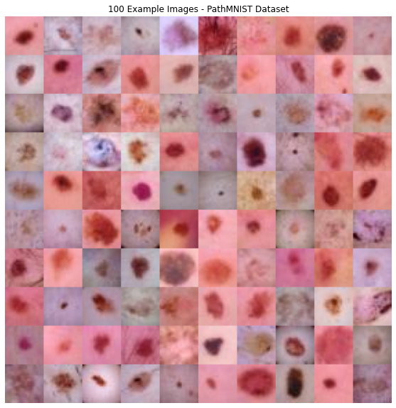
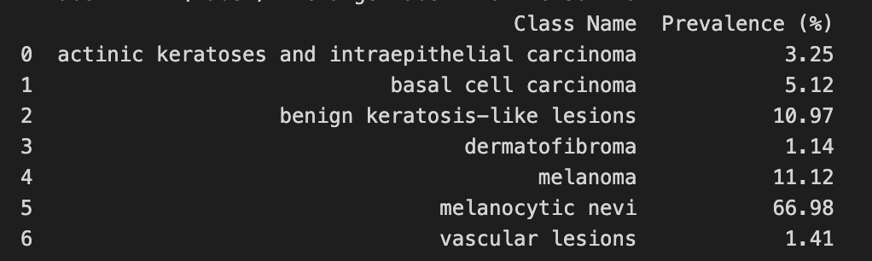
Results: Class Distribution
The dataset has large class imbalances
Melanocytic nevi accounts for ⅔ of the data
Remaining classes are underrepresented, particularly dermatofibroma & vascular lesions
Impact on learning:
Model is biased toward majority class predictions
During training, the loss function is dominated by the majority class, making it harder for the model to learn features from minority classes
Subset of skin lesion imaging data used to train model on multi-class classification

Slide 13
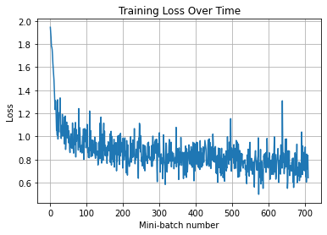
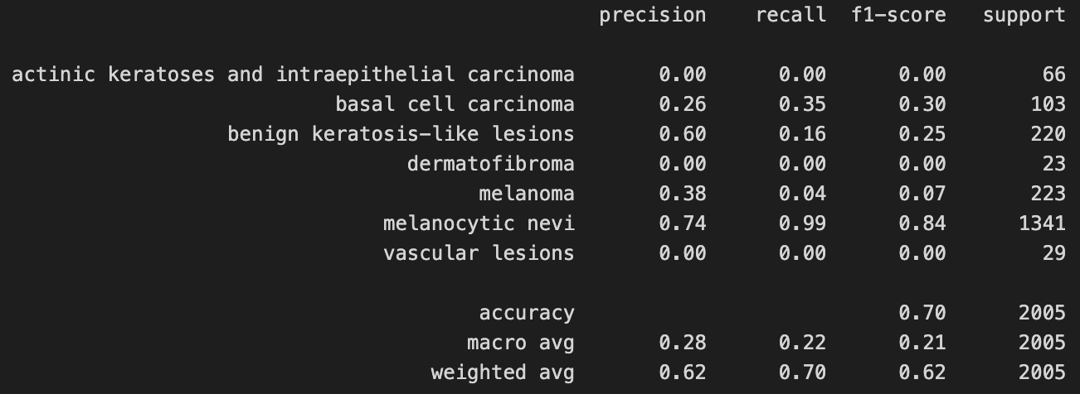
Key Findings
Training loss trend show clear improvement over time (downward slope) → an indication that the model is successfully learning
Model is able to discriminate fairly well between classes (AUC: 0.838) w/ an overall accuracy 0f 0.7
As expected from the data imbalance, the model is biased → Analysis reveals that the model performs well on Melanocytic Nevi classes, but fails on underrepresented classes
Melanocytic Nevi (67% of data): High precision (0.74), very high recall (0.99)
Melanoma & Other Minority Classes: Extremely low recall (Melanoma recall = 0.04), F1-scores of 0.00 for classes like actinic keratoses, dermatofibroma

Slide 14
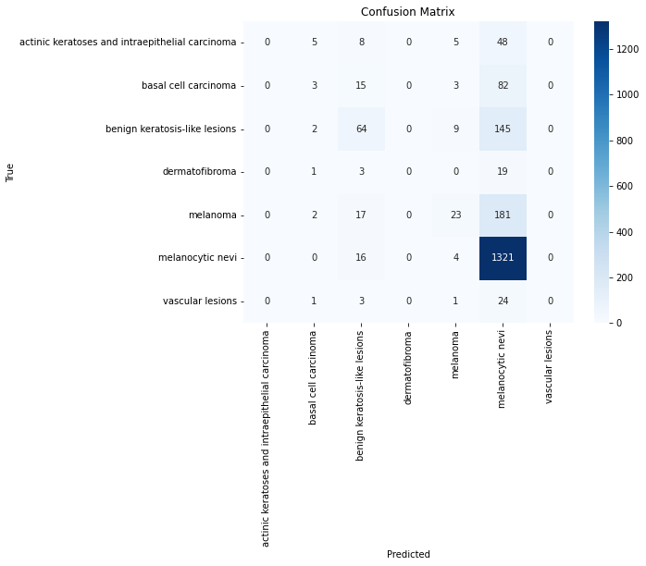
Key Findings (cont.)
This confusion matrix provides further insight into model performance:
Melanocytic nevi were predicted with high accuracy (1,321 correct) - the model excels here (as previously established)
Melanoma shows moderate accuracy, but is often misclassified as benign lesions, which is a major clinical risk
Benign keratosis-like lesions are frequently confused with melanocytic nevi, suggesting overlap in features
Actinic keratoses are rarely correctly predicted and mostly misclassified
Dermatofibroma and vascular lesions are largely misclassified likely due to low sample representation
Overall, the model favors common classes and underperforms on rarer or visually similar categories.

Slide 15
Next Steps: Improving model fairness & performance
Mitigate class imbalance
Apply class-weighted loss to penalize errors on underrepresented classes more heavily during training
Oversample minority classes or augment data to balance training set w/o reducing total data volume ( → this risks information loss)
Evaluation strategy
Tune prediction thresholds to increase sensitivity on rare classes
Enhance model training
Experiment with lower learning rates or potentially gradient clipping to stabilize learning on rare classes

Slide 16
Decisions and Tradeoffs: Model Architecture
Why CNNs?
Spatial locality (good at detecting edges/textures), translation invariance, parameters efficiency
Why not…
Fully connected neural networks | Loses spatial information; requires much higher parameter count for image input
RNNs/LSTMs | Not suitable for image data, only for 2D sequences
Transformers | Overkill for 28x28 image; requires very large dataset and compute

Slide 17
Decisions and Tradeoffs: Model Architecture
Decision | Benefit | Trade-off
4 convolutional layers with ReLU and BatchNorm | Helps gradient flow and training stability; quick run time | Manual tuning of architecture, less generalizable
MaxPooling after some layers | Reduces spatial size and computation | Risk of losing spatial information
Fully connected layer: 64×4×4 → 128 → 128 → num_classes | Appropriate capacity for this dataset | Hardcoded spatial assumptions; no global pooling

Slide 18
Decisions and Tradeoffs: Training Pipeline
Decision | Benefit | Trade-off
Optimizer: SDG with learning rate 0.01 | Simple and well-understood | Slower convergence compared to other optimizers (Adam, etc.)
10 epochs for training | Reasonable “default” for this size data | May be too few epochs for convergence
Batch size of 100 | Efficient memory usage, faster runtime | Might not completely reduce gradient noise beneficial for generalization

Slide 19
Reference
Chao Chen, Nor Ashidi Mat Isa, Xin Liu, A review of convolutional neural network based methods for medical image classification, Computers in Biology and Medicine, Volume 185, 2025, 109507, ISSN 0010-4825, https://doi.org/10.1016/j.compbiomed.2024.109507.
Jiancheng Yang, Rui Shi, Donglai Wei, Zequan Liu, Lin Zhao, Bilian Ke, Hanspeter Pfister, & Bingbing Ni. (2024). [MedMNIST+] 18x Standardized Datasets for 2D and 3D Biomedical Image Classification with Multiple Size Options: 28 (MNIST-Like), 64, 128, and 224 (3.0) [Data set]. Zenodo. https://doi.org/10.5281/zenodo.10519652
Jiancheng Yang, Rui Shi, Donglai Wei, Zequan Liu, Lin Zhao, Bilian Ke, Hanspeter Pfister, Bingbing Ni. Yang, Jiancheng, et al. "MedMNIST v2-A large-scale lightweight benchmark for 2D and 3D biomedical image classification." Scientific Data, 2023.
Sarvamangala DR, Kulkarni RV. Convolutional neural networks in medical image understanding: a survey. Evol Intell. 2022;15(1):1-22. doi: 10.1007/s12065-020-00540-3. Epub 2021 Jan 3. PMID: 33425040; PMCID: PMC7778711.
Yang, J., Shi, R., Wei, D., Liu, Z., Zhao, L., Ke, B., Pfister, H., & Ni, B. (2023). MedMNIST v2: A large-scale lightweight benchmark for 2D and 3D biomedical image classification. Scientific Data, 10(1), 41. https://doi.org/10.1038/s41597-022-01721-8

